Slide 1

Sample Size : 6918
वास्तुविस्ता
FUTURE PROSPECTS IN REAL ESTATE PRICE MODELLING
Presented By: Aditya Gupta
Mentor: Priyanka Dangar & Priyesh Tiwari

Slide 2

Introduction
Sample Size : 6918
House price prediction can help the developer determine the selling price of a house with respect to a location and can help the customer to arrange the right time to purchase a house.
There are three factors that influence the price of a house which include physical conditions, concept and location.
Real estate is least transparent industry in our ecosystem.
House prices increase every year, so there is a need for a system to predict house prices of the future so that one can gain maximum profitability.
We aim to make evaluations based on every basic parameter that is considered while determining the price.

Slide 3

Objective
Sample Size : 6918
Develop a House Price Prediction model to provide potential buyers and sellers with the comprehensive insights into the property values. The model will enhance decision-making within the real estate market, enabling more informed transactions and negotiations.
Dataset
Source: Kaggle
Link: https://www.kaggle.com/datasets/amitabhajoy/bengaluru-house-price-data
Geography: Bengaluru
No. of Variables: 9
No. of Observations: 13320
Tool Used: Python

Slide 4

Variable Description
Sample Size : 6918
Variable Name | Type | Description
Area Type | Categorical | Type of Plot
Availability | Binary | Ready to Move or Not
Location | Categorical | Region of Bangalore
Size | Numeric | BHK
Society | Categorical | Colony in which the House is Present
Total Sq. Ft. | Numeric | Total Area
Bath | Numeric | Number of Bathrooms
Balcony | Numeric | Number of Balconies
Price | Numeric | Cost in Lakhs

Slide 5


Flow Chart
Sample Size : 6918
Exploratory Data Analysis (EDA)
Data Preparation for M.L. Model
Data Cleaning
Feature Engineering
Outlier Removal
One Hot Encoding
Linear Regression Model Training
Variance Inflation Factor (VIF)
Ridge Regression
Support Vector Machine (SVM)

Slide 6

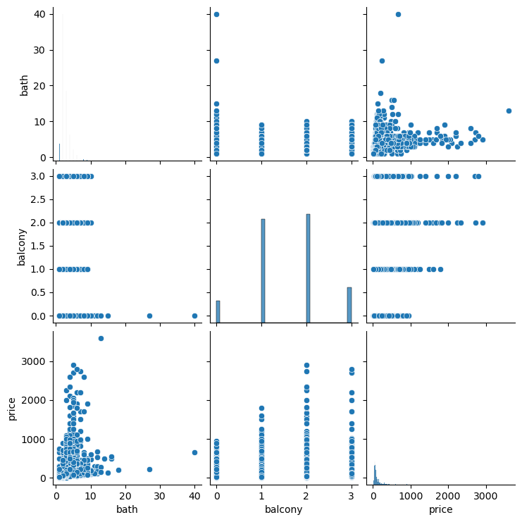
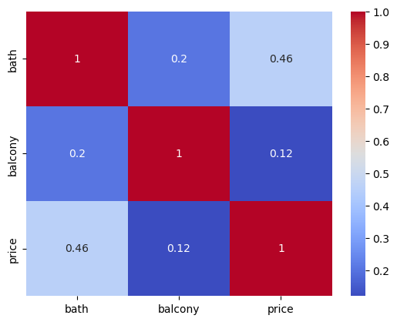
Exploratory Data Analysis (EDA)
Sample Size : 6918
Exploratory Data Analysis refers to the critical process of performing initial investigations on data so as to discover patterns, to spot anomalies, to test hypothesis and to check assumptions with the help of summary statistics and graphical representations.
Bath and Price have slightly linear correlation with some outliers
Correlation of Bath is greater than Balcony with price

Slide 7

Data Preparation for ML Model
Sample Size : 6918
Data Cleaning:
Feature Engineering:
Variable | Missing Obs.
Area Type | 0
Availability | 0
Location | 1
Size | 16
Society | 5502
Total Sq. Ft. | 0
Bath | 73
Balcony | 609
Price | 0
As society has 5502 missing observations which is almost 50% of the data. So dropping of Society variable was best possible solution. And for other variables like Location, Size, Bath, Balcony, missing observations were dropped.
Variable | Obs. Format
Total Sq. Ft. | 2830 - 2882
 | 1752.12
 | 142.61Sq. Meter
 | 4125Perch
For Total Sq. Ft., the observations which were in range, the mean value was taken and float values were converted to whole number. Whereas observations in string format changed to whole number.

Slide 8
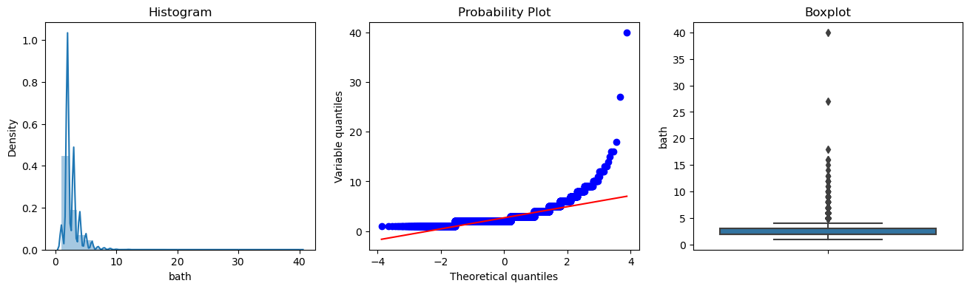
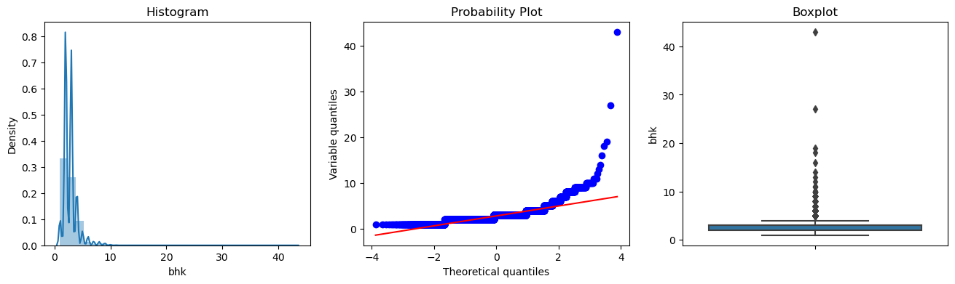
Data Preparation for ML Model
Sample Size : 6918
Outlier Removal:
From the Boxplot, if we observe than there are houses with more than 5 baths. These observations are outlier and can affect the model prediction. Similarly for the bhk variable, houses with more than 5 bhk can be considered as outlier. So those observations were removed from the data.

Slide 9

Data Preparation for ML Model
Sample Size : 6918
One Hot Encoding:
This technique is used to convert the categorical variables into numeric values.
My dataset contains categorical variables which are ‘Area Type’, ‘Location’ and ‘Society’.
After generating the dummy variables for the categorical features, the dataset dimensions transformed from (7120,9) to (7120, 820). Upon applying One-Hot Encoding to these categorical variables, the dataset size shrank to (7120,111). Notably, the ‘Location’ variable was primarily responsible for this substantial dimension shift. Given that the ‘Location’ variable was deemed to have minimal impact on model predictions, it was subsequently excluded from the model.

Slide 10
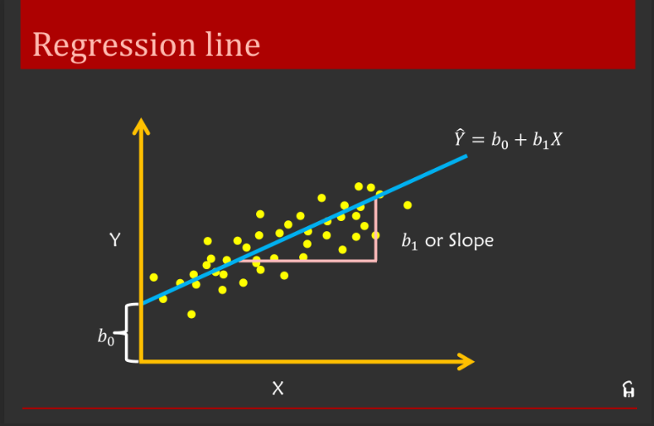
Linear Regression Model Training
Sample Size : 6918
The process of modelling means training a Machine Learning algorithm to predict the labels from the features.
I have used the Linear Regression algorithm for training and testing of the model.
The R-squared value of 0.8602571050153061 means that The Model is able to explain approximately 86.02% variability in the model.
RMSE Score = 37.231422372570734

Slide 11
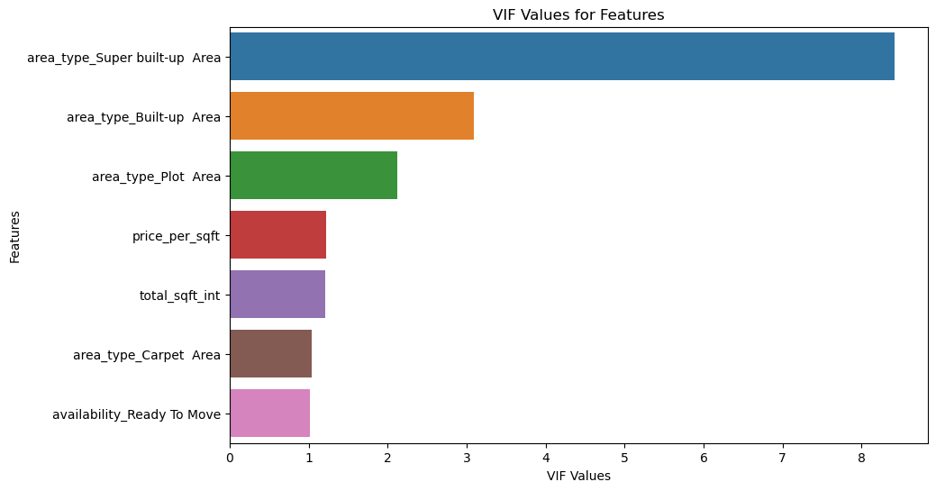
Model Assumptions
Sample Size : 6918
Variance Inflation Factor
Since VIF value for area_type_Super built-up Area is greater than 5. Which means Multicollinearity is present in the data. So we’ll go for Ridge Regression.

Slide 12
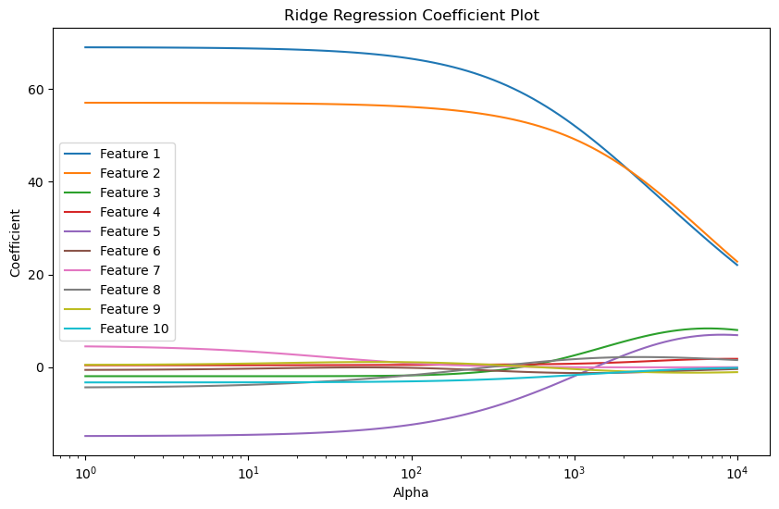
Ridge Regression
Sample Size : 6918
Ridge Regression is a regularization technique used in Machine Learning model also known as L2 regularization.
It is used to deal with the problem of Multicollinearity and Overfitting.
Ridge Regression model adds a penalty term in the cost function of Linear Regression.
Ridge Regression performs feature selection by shrinking the estimates towards zero.
The R-squared value of 0.8602756801117902 means that The model is able to explain approximately 86.02% variability in the model. Which is same as Linear Regression model prediction.
RMSE Score = 37.228947827277715

Slide 13
Model Coefficients
Sample Size : 6918
Variable | LR Coefficients | Ridge Coefficients
β₀ | 135.21934894971616 | 135.1027543939328
bath | 69.02320245 | 68.99651273
balcony | 57.04929496 | 57.03968734
total_sqft_int | -1.95670271 | -1.9573933
Bhk | 0.39827991 | 0.39980158
price_per_sqft': | -14.89272858 | -14.86397877
area_type_Built-up | -0.64326498 | -0.60084243
area_type_Carpet Area | 4.63046935 | 4.47106526
area_type_Plot Area | -4.43651262 | -4.36283194
area_type_Super built-up Area | 0.44930825 | 0.4926091
availability_Ready To Move | -3.30283139 | -3.30081223

Slide 14
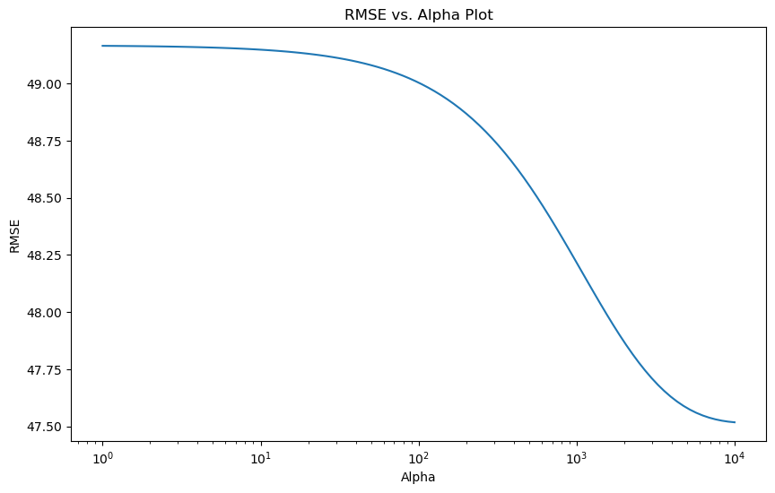
Ridge Regression
Sample Size : 6918
Hyperparameter Tunning
After performing the Hyperparameter selection, I got the Best Alpha as 10000 .
When run the model with best alpha.
The model performance score was 0.859500457127703 which is 86.0%.
RMSE Score = 37.33208239684906

Slide 15
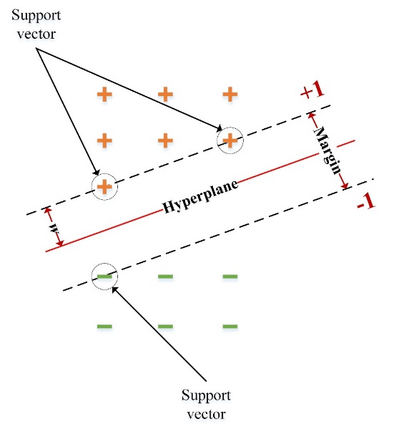
Support Vector Machine (SVM)
Sample Size : 6918
Support Vector Machine or SVM is a Supervised Learning algorithms, which is used for Classification as well as Regression problems in Machine Learning.
The goal of the SVM is to create a decision boundary that can segregate n-dimensional space into classes so that we can easily put the new data point in the correct category in future. The best decision boundary is called a Hyperplane.
SVM chooses the extreme points/vectors that helps in creating the Hyperplane. These extreme points are called as Support Vectors, and hence algorithm is termed as Support Vector Machine.
Class 1
Mixed Data
Class 2
SVM
Class 3
Class 4

Slide 16
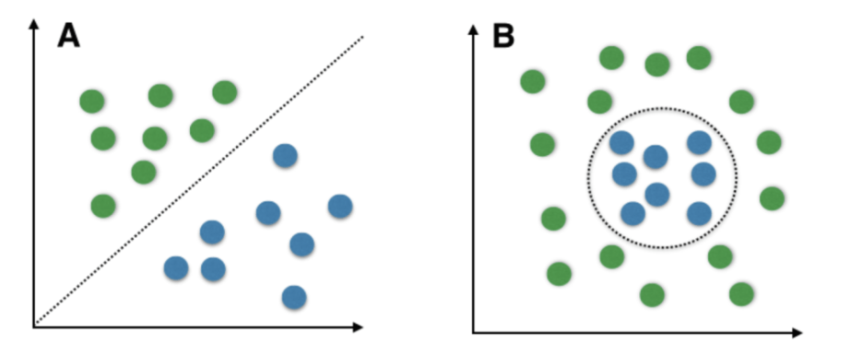
SVM Classifiers
Sample Size : 6918
There are 2 kinds of SVM Classifiers
Linear SVM Classifier
Non-Linear SVM Classifier
Linear vs Non-Linear

Slide 17
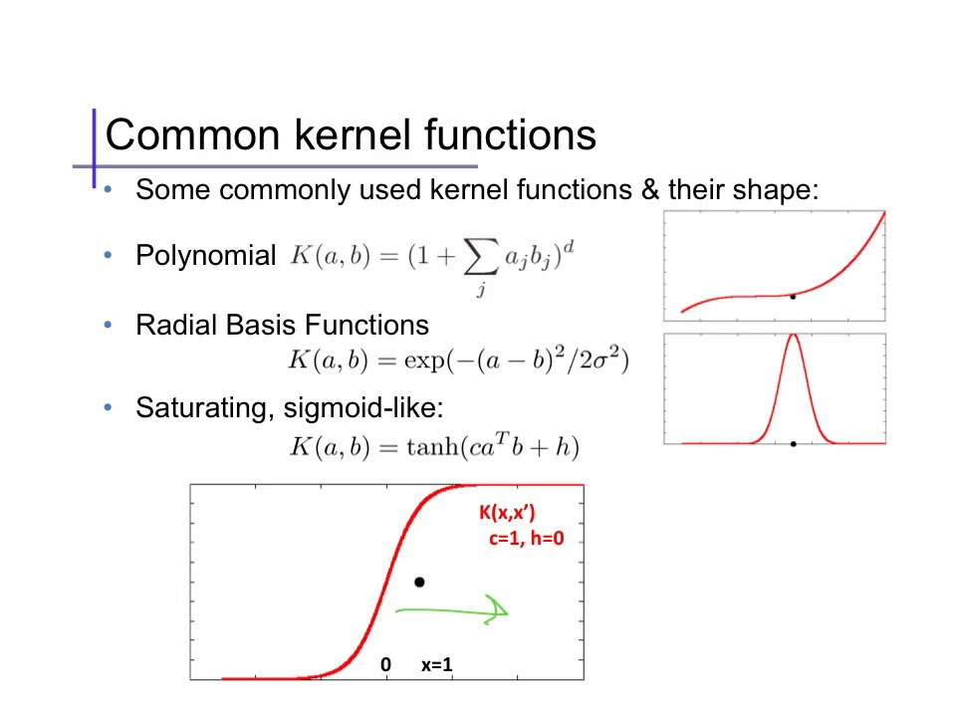
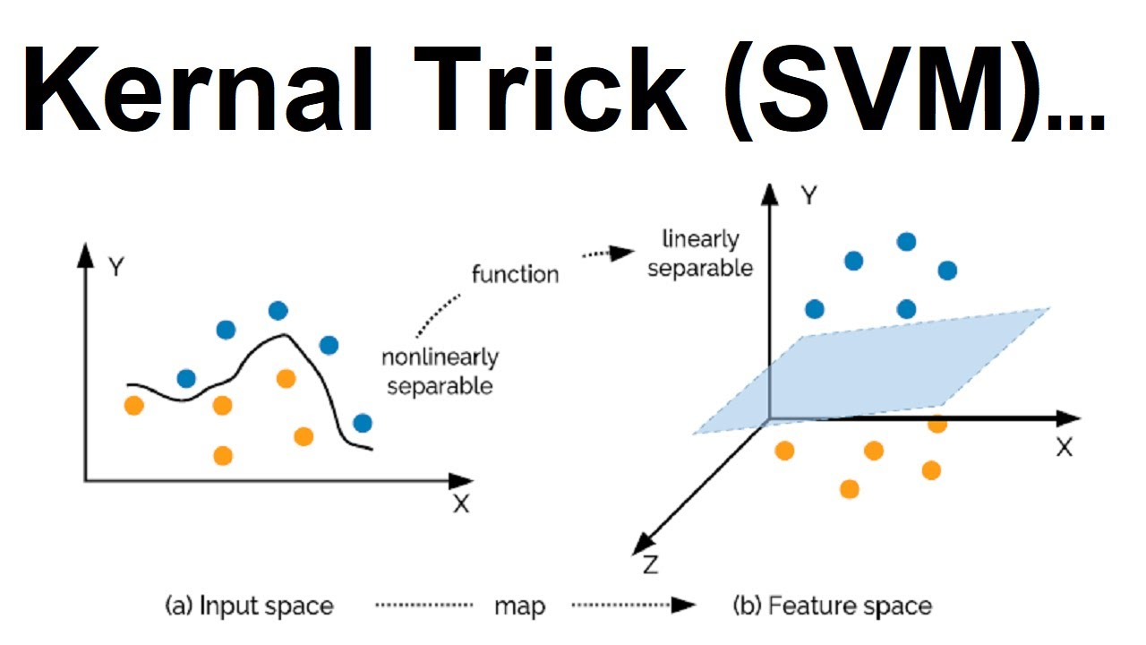
Tunning Parameters: Kernal
Sample Size : 6918

Slide 18
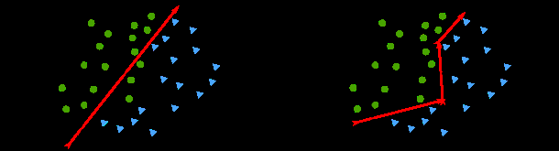
Tunning Parameters: Regularization
Sample Size : 6918
To avoid misclassification of each training example
Low Regularization Value
High Regularization Value

Slide 19
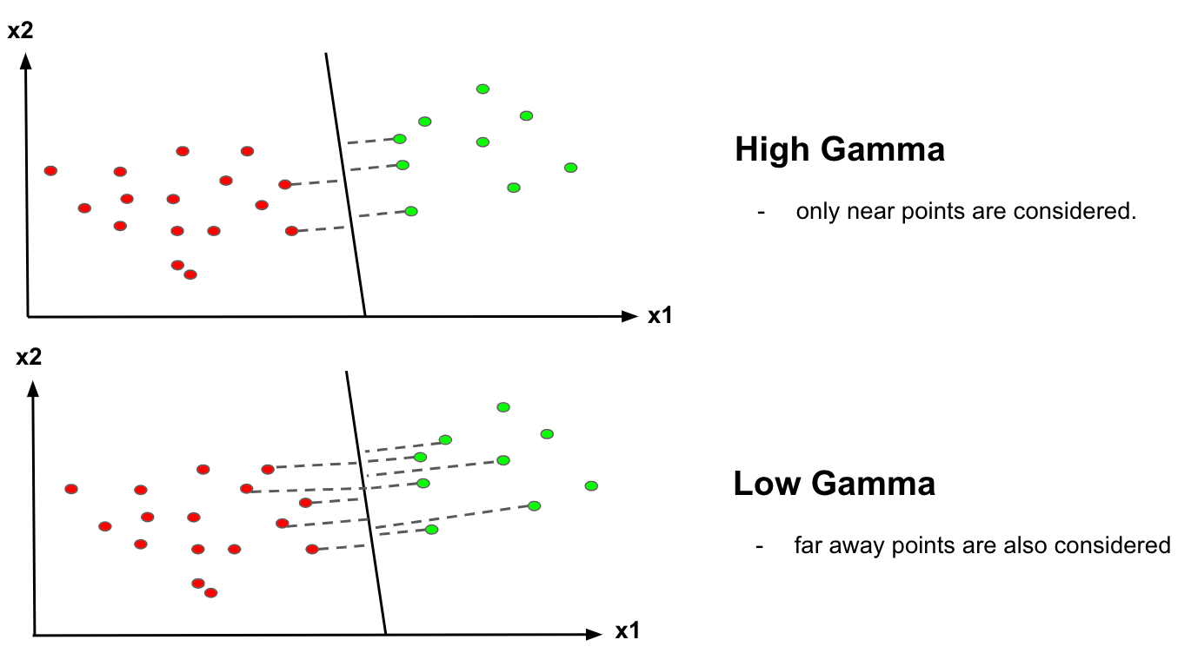
Tunning Parameters: Gamma
Sample Size : 6918
Gamma is a hyperparameter that controls the flexibility and complexity of the model's decision boundary. Gamma determines the range of influence of individual data points on the shape of the decision boundary.

Slide 20
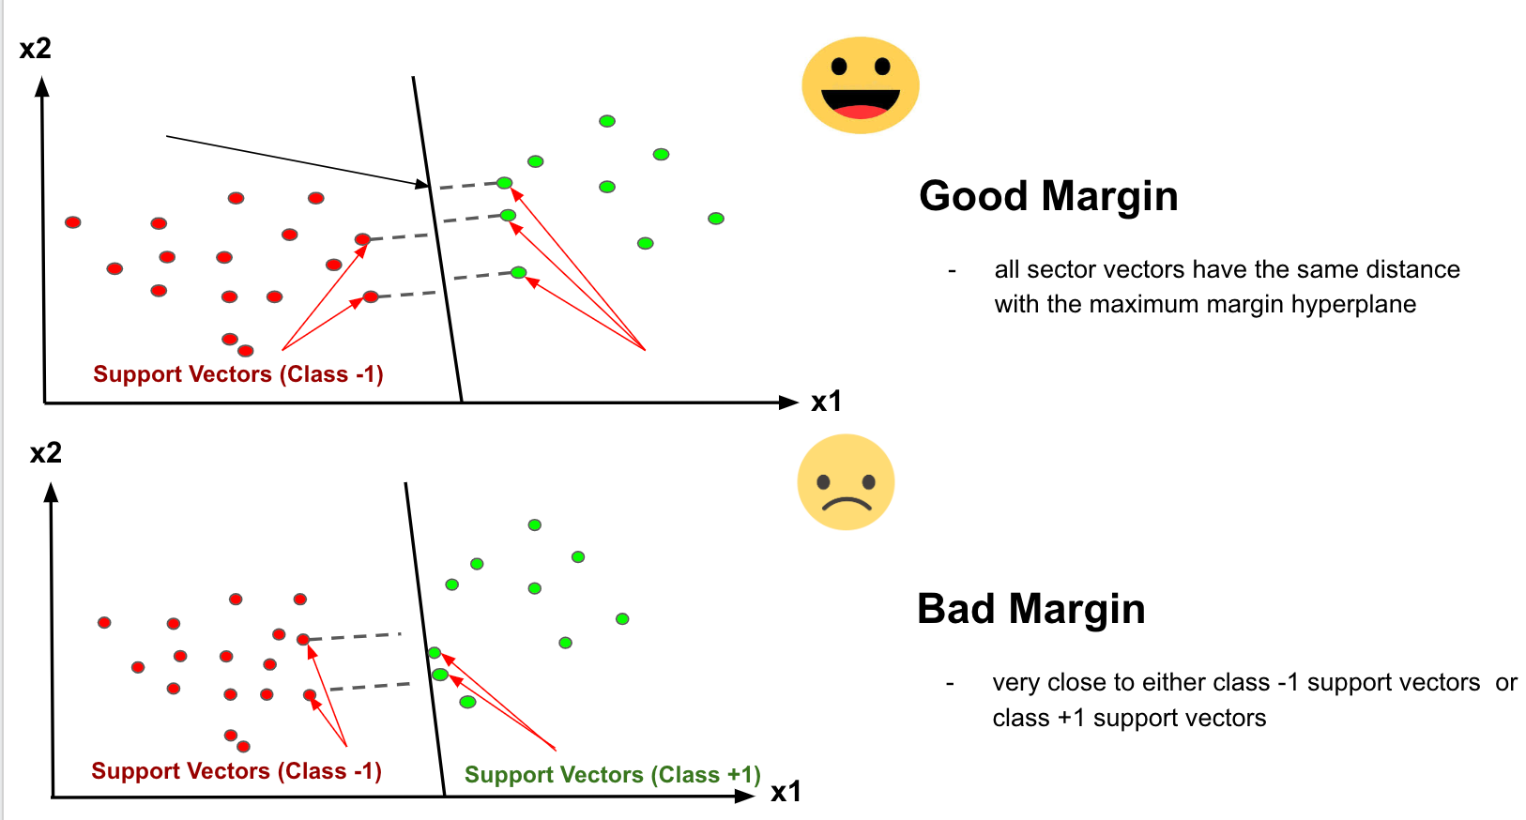
Tunning Parameters: Margin
Sample Size : 6918

Slide 21
Performance Metrics
Sample Size : 6918
Kernal | Best Hyper Parameters | RMSE | R-Square
linear | {'C': 100, 'gamma': 0.001} | 43.26665243399351 | 0.8112803729644541
rbf | {'C': 100, 'gamma': 0.01} | 35.68954014031426 | 0.8715919106183342
sigmoid | {'C': 100, 'gamma': 0.001} | 46.74849372142302 | 0.7796841593292427
Looking at the RMSE and R-Square values of the SVM model with different kernel. We can conclude that the SVM model with ‘rbf’ (Radial Basis Function) kernel is performing better on this data as the RMSE = 35.7 indicating it has the smallest average prediction error and R-sq = 87.16% suggesting that the model is able to explain the variance relatively well in my data.

Slide 22
Thank You!

